Slide 1
3.6 Sequential Circuits
60
Sequential circuits are used anytime that we have a “stateful” application.
  A stateful application is one where the next state of the machine depends on the current state of the machine and the input.
A stateful application requires both combinational and sequential logic.
The following slides explain the operation of a register, memory, and a binary counter.
  These essential components of a computer are based on this technology.

Slide 2
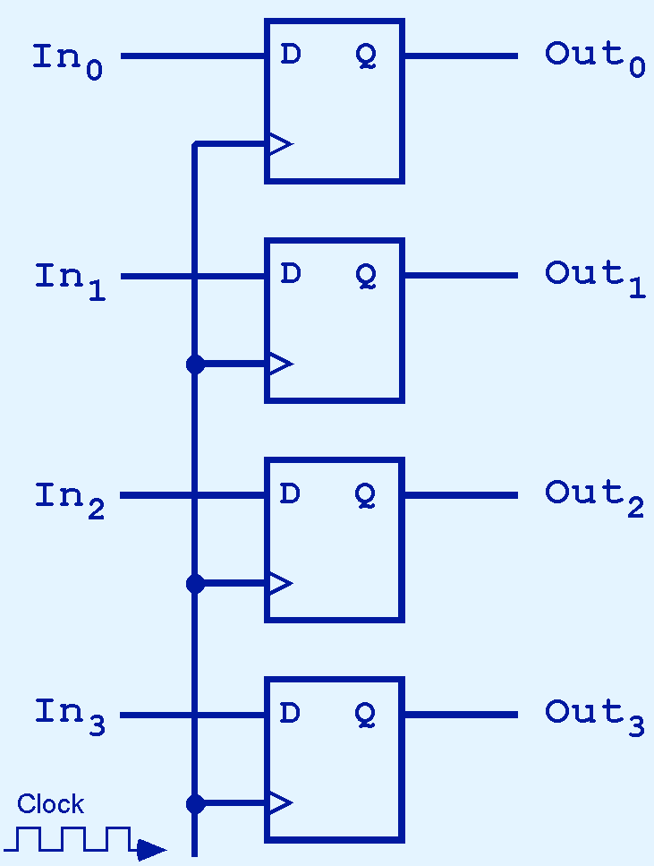
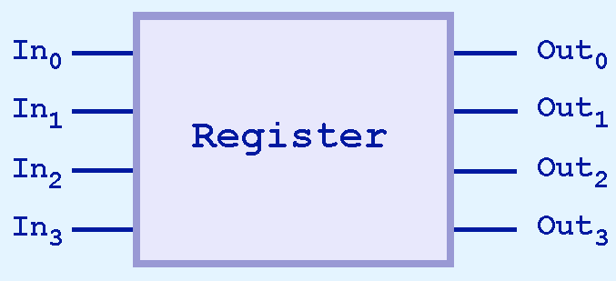
3.6 Register
61
This illustration shows a 4-bit register consisting of D flipflops. You will usually see its block diagram (below) instead.

Slide 3
3.6 Register
61b
This register maintains its state as the clock ticks because the value of In_{n} is equal to the value of Out_{n}.
The small triangle in each flipflop represents the clock input. The clock is connected to each bit of the register.

Slide 4
3.6 Memory
61c
Slide 62 is a picture of four words of memory.
  Each word has 3 bits, represented in one column.
  Print out slide 62 and color over each line as it is discussed on the following slides.
A 4-word memory needs 2 selector lines to address the four words
  We need to know which word the data is going to or from.
  Note that S₁ is the high-order bit even though it’s shown on the right. Look carefully at the AND gates S₀ and S₁ feed into.
When data is being written into memory, it comes from the 3 input bits on the left.
  In₀ is connected to bit 0 of each word, but the update only happens if the corresponding selector line is 1 (and the write enable bit is 1) when the clock ticks.

Slide 5
3.6 Memory Read (= Output)
61d
When data is being read from memory (i.e., output), it goes into the 3 output bits on the right.
  Each output bit contains the ‘OR’ of the corresponding output bits from the four words.
  Only one of those bits can be true at any one time. That’s the output bit from the word that is selected, i.e., the word whose number (address) is represented by the selector lines.
Memory read (i.e., output) does not require a clock tick.
  The output is always there. To get the data from the Q signals for each memory cell to Out only requires combinational logic. (For a refresher, see picture on slide 3f-51 or characteristic table on 3f-51.)
  The clock isn't needed for combinational logic.

Slide 6
3.6 Memory Write (= Input)
61e
However, memory update (i.e., input) only happens when the clock ticks.
  That’s the only time the clock bit in the lower left is on.
  Input is sampled on the rising edge and the output is stable by the time of the falling edge.
Also, memory update (i.e., input) only happens when the write enable bit is on.
  Memory can only be updated when the “write enable” bit is on. There is a write enable line that is AND-ed with the clock. Look for it in the lower left corner of slide 62.
  The clock ticks regularly, and there is always some value on the input lines (every bit is either 0 or 1), but we don’t want to update memory every time the clock ticks.
  So we only turn the write enable bit on when we want to update memory.

Slide 7
3.6 Memory Write: Example
61f
Writing to memory
  We will use bit 0 as an example. All 3 bits act the same way.
  Input In₀ is connected to bit 0 of each of the words
  But the data in bit In₀ does not flow to bit 0 of each word. It only flows to the word represented by the selector.
  Furthermore, the new value from I₀ is only written when the clock ticks and write enable is on. (You can see the clock line and the write enable line AND-ed together, and that result AND-ed together with the selector line for the column.)
  If write enable is off or the particular word is not selected, the data in the memory remains the same. That’s how a D flipflop works, and it’s also what you’d expect from a computer memory. We want values to be stable unless updated.

Slide 8
3.6 Memory Read: Example
61g
Reading from memory
  We will use bit 0 as an example again.
  Bit 0 of each word is AND-ed to the selector for that word number (i.e., that word’s address).
  So bit 0 of a given word is only output from the D flipflop it’s stored in when the selector for that word is on.
  All of the bit 0’s from the different words are OR’d together to form output bit Out₀, but only one of them (the one from the selected word) will have a 1 in it.
  So the value of Out₀ will contain the value of bit 0 of the selected word, i.e., whatever is in the D flipflop. If the word had been updated during this clock cycle (as explained on the previous slide), Out₀ will contain the new value. Otherwise it will contain the old value. Again, that’s what we expect from a computer memory.

Slide 9
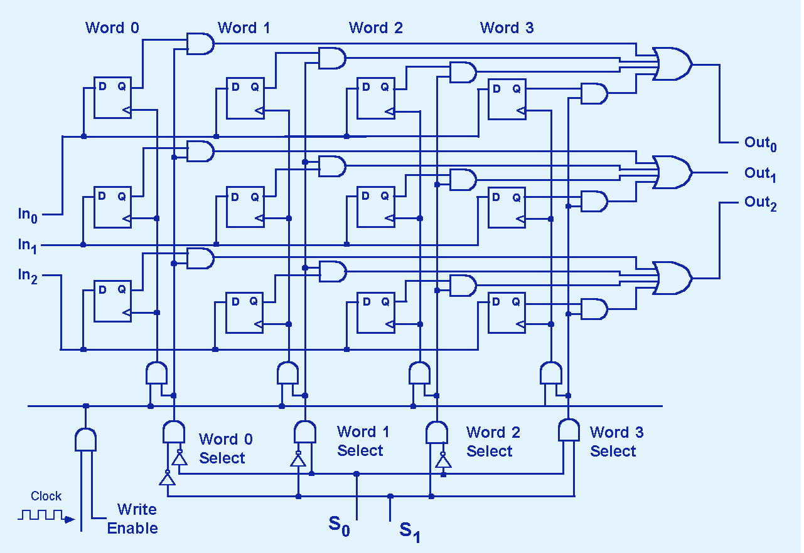
3.6 Memory
62

Slide 10
3.6 Memory Use: y = x
62b
Example 1: Implementing y = x
  In binary, that is: LOAD X; STORE Y.
  So first read the value of x from memory:
  Load the address of x on the selector lines (S₁S₀ on slide 62).
  Now the value of x will be available on the Out lines.
  Then write the value of y into memory:
  Load the address of y on the selector lines.
  Load the new value of y (i.e., the value of x) on the In lines.
  Turn on the write enable bit.
  The next time the clock ticks, the new value of y will be loaded into the cells pointed to by the address of y.

Slide 11
3.6 Memory Use: y = x + 1
62c
Example 2: Implementing y = x + 1
  Basically the same as the previous slide.
  Just use the ALU on 3e-40f to calculate x+1 (or any other expression) between the first and second steps on the previous slide.
  Directions for using the ALU can be found on 3e-40c.

